Slide 1

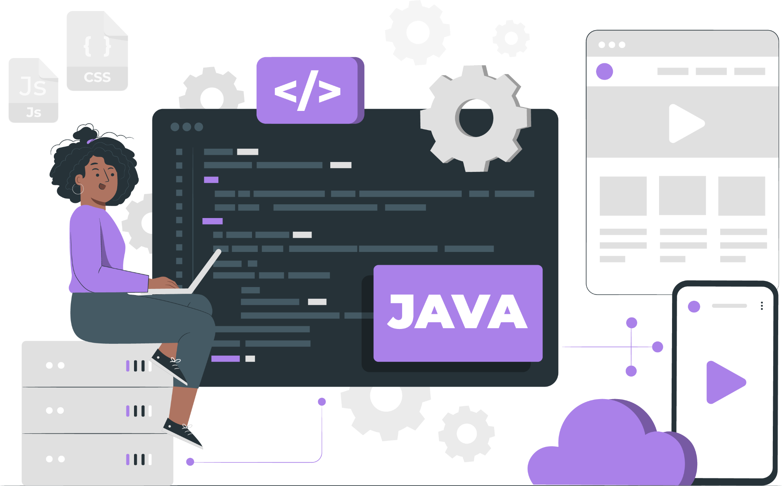
Lecture
Spring

Slide 2
List of Concepts Involved:
Spring Introduction
Spring core
Spring Boot
Introduction to Spring MVC
Spring MVC Architecture

Slide 3
Topics covered Yesterday's Session:
Hibernate Framework

Slide 4
Spring Introduction
Java Learning is all about 3 things
a. Java Language(Core java course)
b. Java Technology(JDBC,Servlet,JSP,JSTL,EJB's,JMS,....)
c. Framework(Hibernate,Spring,SpringBoot,Rest Api's,....)

Slide 5
Different types of Framework to build application
Web application based framework
ORM Framework
Application Framework
Distributed Application Development framework etc....

Slide 6
How Spring evolved?
1995 =>Applet
1996 =>JavaBean
1998 =>EJB(Enterprise java Bean)
2002/2003=> Spring Framework --------> Rod Johnson

Slide 7
Is Spring alternative to EJB, Struts technology?
Spring vs EJB
Answer. No , Spring framework is used to develop all kinds of app.
Web Services are alternative to EJB's.
Spring Vs Struts
Answer. No, Struts will be used to build only web based application
Spring can be used to build any type of application.
SpringMVC is an alternative to Struts.

Slide 8
Is Spring alternative to Hibernate,JEE technology?
Spring vs Hibernate
Answer. NO, hibernate is orm framework to build persistence logic
Spring has its own orm module through which it promotes abstraction
Spring ORM,SpringDataJPA is an alternative to hibernate.
Spring vs JEE(Java Enterprise Edition)
Answer. No, JEE is a technology which gives api for persistence logic and building webapps.
Where as Spring provides an abstraction on top of JEE api's
Spring JDBC-> JDBC,SpringMVC-> Servlet,JSP

Slide 9
Spring Core
It is base module for other modules
This module is given to supply Spring Containers to perform Dependency management.
This module gives 2 spring containers/IOC[Inversion Of Control] containers called
BeanFactory
ApplicationContext(Latest one)

Slide 10
Spring Applications can be developed in 4 approaches
XML approach(only used in maintenance projects).
using Annotation driven configuration.
using java code configuration.
using Spring boot auto driven configuration.

Slide 11
Dependency Injection in setter way
Link

Slide 12
THANK YOU

